Slide 1
Client Case 2020-2021 : Combinatorial Optimization: CVRPTW & TRSP
Based on the VeRoLog solver challenge 2019

Slide 2
Context
Within the EURO (https://www.euro-online.org/web/pages/1/home) VeRoLog (http://www.verolog.eu/) is an important working group.
Routing and logistics are sources of important combinatorial optimization problem
Every few years, the organization launches a `solver challenge’ focusing on a hard combinatorial problem
The last one was https://verolog2019.ortec.com/

Slide 3
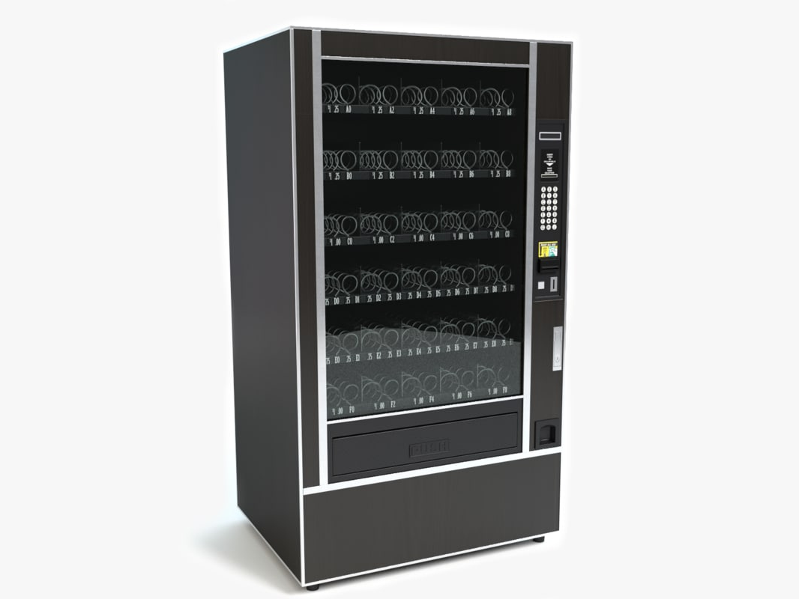
Imagine a vending machine…

Slide 4
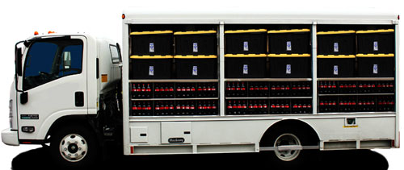
They are first transported to their standing place

Slide 5
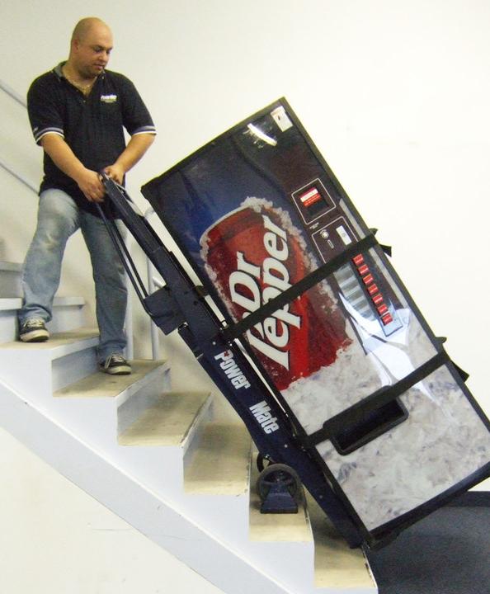
Transportation team delivers them

Slide 6
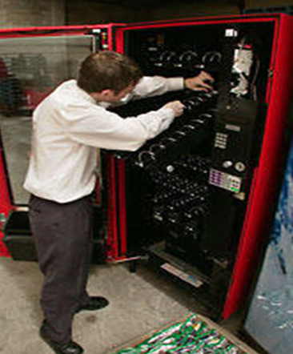
Before usage they need to be installed by a skilled technician

Slide 7
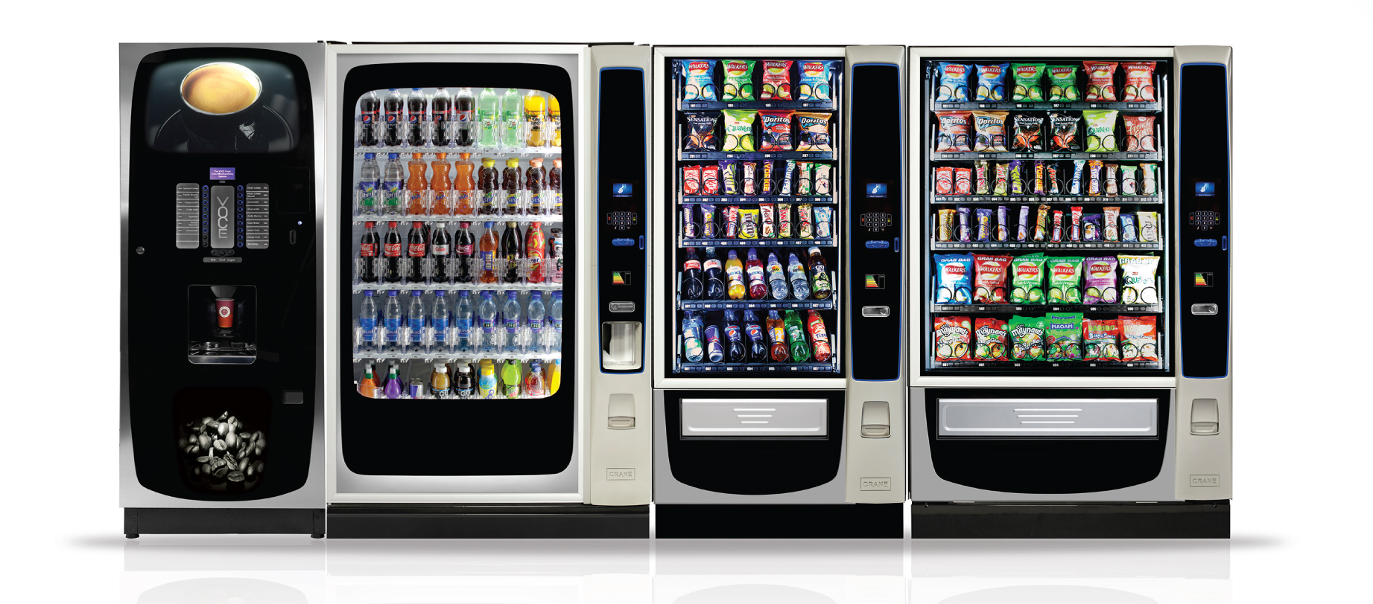
They are of several types

Slide 8

Different type of machine requires different technician skills

Slide 9

And engineers are also entitled days off… After each sequence of 5 working days the technician is unavailable to work for 2 days. Not all technicians rest simultaneously.

Slide 10
Delivery vs installation
To deliver the machines, all trucks start and end their route at a central depot. All trucks have the same capacity and the same maximum distance they can travel per day (homogeneous fleet).
To install the machines, each technician starts and ends their route at his/her home location. There are no vehicle capacities for technicians, but each has a given maximum distance they can travel per day, and a maximum number of installations they can do per day.
Naturally, a machine can only be installed after it has been delivered.

Slide 11
Objective function
A weighted sum of:
Distance traveled by trucks
Cost for using a truck for a day
Cost for using a truck at all during the planning horizon
Distance traveled by technicians
Cost for using a technician for a day
Cost for using a technician at all during the planning horizon
Costs for every full day a machine is idle, specified for each kind of machine.

Slide 12
Problem ingredients
Horizon of several days
Machine distribution tasks with a window of possible delivery days
Large fleet of homogeneous trucks with limited loading capacity
Pool of specific technicians with skills that should match the machine type
Technicians must be given regular days of rest
The earliest a machine can be installed, is the day after delivery
Cost function as a weighted sum of several cost elements

Slide 13
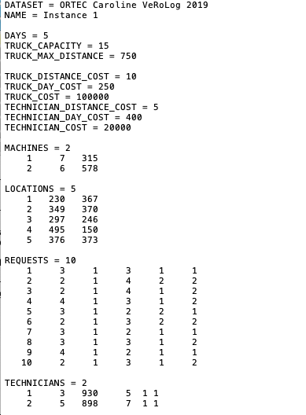
The instance format
Each instance is provided in a text file.
The structure of the instance text file is explained in the document CO_case.pdf.
The first few instances are rather small and ideal to play with in order to understand the structure of the problem.

Slide 14
The solution format
Each solution should be provided in a text file.
The structure of the solution text file is also explained in the document CO_case.pdf.
For the sake of illustration, we included an example solution file (included in validator.zip)
DATASET = EXAMPLE SET
NAME = example002
DAY = 1
NUMBER_OF_TRUCKS = 4
1 7 2 6
2 1
3 4 3
4 5
NUMBER_OF_TECHNICIANS = 0
DAY = 2
NUMBER_OF_TRUCKS = 2
1 8 9
2 10
NUMBER_OF_TECHNICIANS = 2
1 2 7 1 4
2 6 3 5
DAY = 3
NUMBER_OF_TRUCKS = 0
NUMBER_OF_TECHNICIANS = 2
1 9 10
2 8
DAY = 4
NUMBER_OF_TRUCKS = 0
NUMBER_OF_TECHNICIANS = 0
DAY = 5
NUMBER_OF_TRUCKS = 0
NUMBER_OF_TECHNICIANS = 0

Slide 15
The validator
For convenience, code in python is provided to validate and verify the objective value of a solution:
→ validator.zip
Using the validator is very simple, you provide it with two arguments (the instance file and the solution file): Python Validate.py --instance example002.txt --solution example002sol.txt
For the example in validator.zip you should obtain
Solution example002sol.txt is a valid solution
The given solution information is correct
TruckDistance: 1551
NrTruckDays: 6
NrTrucksUsed 4
TechnicianDistance: 1119
NrTechnicianDays: 4
NrTechniciansUsed: 2
IdleMachineCost: 0
Cost: 464205

Slide 16
The rules
- Use python3. You may use python packages, and any other free or “free for academic use” software (including but not limited to Cplex, Gurobi, Concorde TSP solver, GoogleORTools). - Submit a python file (or even better: organize your code in multiple files). Make sure the main file is called Solver.py. The submitted program should accept 2 command-line arguments, in the following order: input file name and the calculation time in seconds. So it can run for example like this: python3 Solver.py CO_Case2021_01.txt 900 - After the run time (in this example 900 seconds), your code must have produced a solution written to a textfile, for example CO_Case2021_09sol.txt)

Slide 17
20 second round
You are also asked to run your code for just 20 seconds per instance and provide the objective value in the report.
Windows: find a tool called “Benchmark_64.exe”. Run this to obtain a factor, for example if the program gives a result of 0.5, then you should allow 20*0.5 = 10 seconds per instance on your own computer.
Mac: use 10 seconds instead

Slide 18
Publications on this topic
A comparison of exact models for the delivery and installation vehicle routing problem from the VeRoLog challenge 2019
https://www.ubvu.vu.nl/pub/fulltext/scripties/27_2578602_1.pdf
Columnwise neighborhood search: A novel set partitioning matheuristic and its application to the VeRoLog Solver Challenge 2019
https://onlinelibrary.wiley.com/doi/full/10.1002/net.21961

